Slide 1

Database Design & Applications
Enhanced ERD - Case Study

Slide 2
University Case
The university stores information about employees, Students and Alumni.
For Employee: SSN, Name, Gender, Address, Birthdate and Salary is stored.
Employees could be of three types : Staff, Faculty and Student Assistant.
Staff could be distinguished on the basis of their position like manager, clerk or peon etc.
A faculty could pertain some rank like Lecturer, Assistant Professor, Professor etc.
The student_Assistant can study in the university but spend some percentage of time for working as student_assistant.
The student assistants could be of two types: Research Assistant (Working under some research project) and Teaching_Assistant (Working under some faculty to giving assistance in course delivery).
For each students the information stored is : SSN, Name, Gender, Address, Birthdate and Major department.
The students could be categorized into undergraduate and postgraduate students.
The information about Alumni is : SSN, Name, Gender, Address, Birthdate and Degree(s) and further for each degree the information stored is : Year of completion, Degree_name, Major department

Slide 3
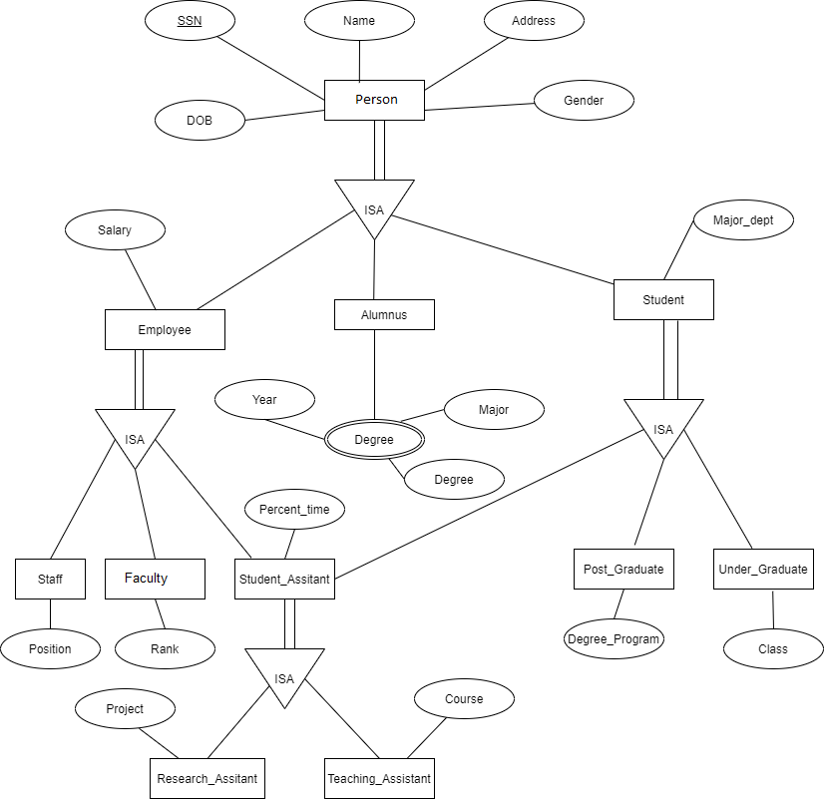
University ERD

Slide 4
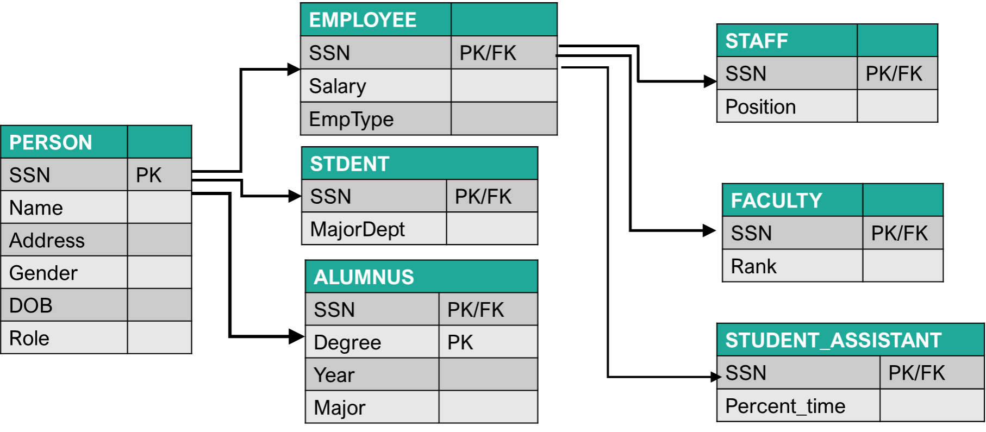
Final University Schema

Slide 5
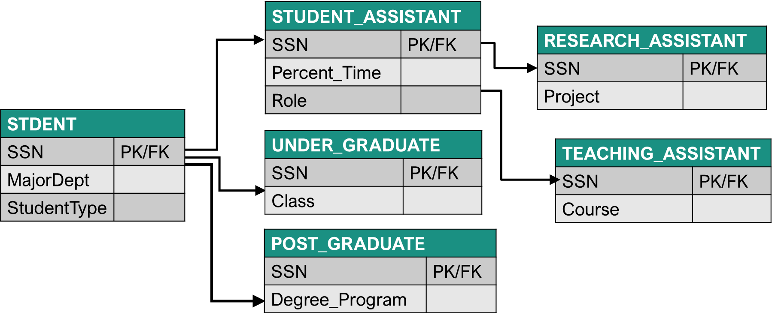
Final University Schema

Slide 6
THANK YOU!

